Slide 1

Intelligent Customer Review Analyzer for E-Commerce
By
Name: AKSHAY Ladha Employee ID : - 8178150 AWS Intern
Manager : Ravi Kumar Jagarlapudi

Slide 2
AGENDA
Introduction
Problem Statement
Approach
System Architecture
Services Used
Final Result
Future Enhancement

Slide 3
INTRODUCTION
E-commerce platforms receive a huge volume of customer reviews, making manual analysis slow and unreliable.
This solution automates the entire review-processing workflow using AWS services to deliver speed, consistency, and scalability.
It uses Amazon Comprehend and a SageMaker model to perform sentiment detection, extract key phrases, and generate concise summaries.
All processed insights are stored in DynamoDB and presented through QuickSight dashboards for easy interpretation.
This helps businesses gauge customer sentiment, spot recurring issues, and enhance products based on data-driven insights.

Slide 4
PROBLEM STATEMENT
• E-commerce platforms generate huge amounts of customer reviews, making it challenging for businesses to manually extract useful insights. • Going through reviews by hand is slow, inconsistent, and prone to mistakes, causing important complaints and sentiment trends to be overlooked. • Traditional methods struggle to identify customer mood, common issues, or rising concerns. especially when handling large datasets across multiple product categories. • Organizations need an automated, scalable, and intelligent system that can analyze reviews, summarize customer feedback, and deliver real-time, actionable insights.

Slide 5
APPROACH
Data Ingestion via S3 Trigger: Customer review CSV files are uploaded to Amazon S3, which automatically activates a Lambda function to initiate the processing workflow.
Automated NLP Analysis with Amazon Comprehend: The ingestion Lambda extracts review text and leverages Amazon Comprehend to identify sentiment and key phrases, transforming unstructured text into meaningful data.
Organized Storage in DynamoDB: The processed information—such as sentiment score, rating, key phrases, and product category—is saved in the ReviewAnalysis DynamoDB table for quick access and analysis.
Review Summarization with SageMaker: A secondary Lambda function fetches the processed reviews, sends them to a SageMaker summarization model, and updates DynamoDB with the generated summary.
Visualization through QuickSight Dashboards: The final dataset and summaries are exported back to S3 and connected to Amazon QuickSight, where KPIs, sentiment trends, word clouds, and review tables are created for insights.

Slide 6
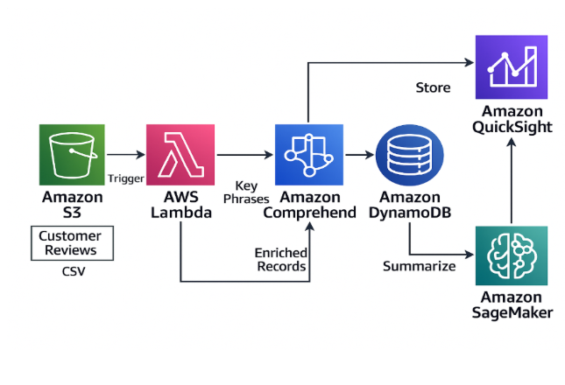
SYSTEM ARCHITECTURE
The solution uses a modular, event-driven workflow where Amazon S3 triggers a Lambda function that carries out NLP tasks using Amazon Comprehend and a BigBird/Pegasus summarization model running on SageMaker. All processed insights are saved in DynamoDB and later presented in interactive dashboards built in Amazon QuickSight.

Slide 7
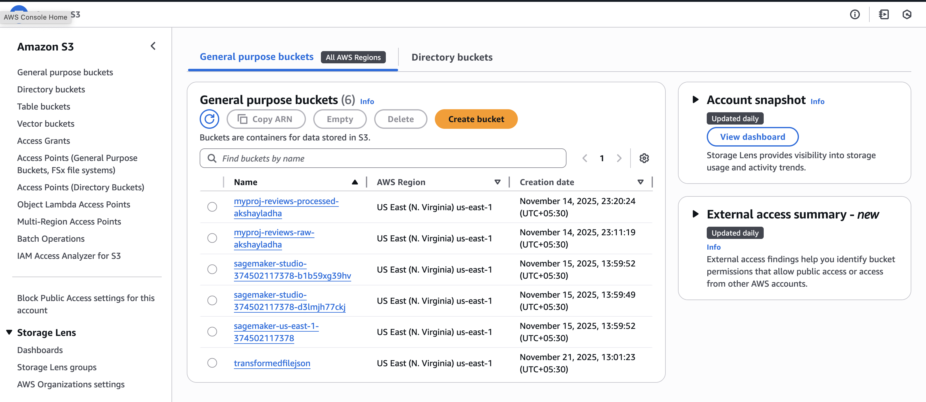
SERVICES USED
1. Amazon S3 (Simple Storage Service)
Used to store raw customer review CSV files. Uploading a file triggers the ingestion Lambda function.

Slide 8
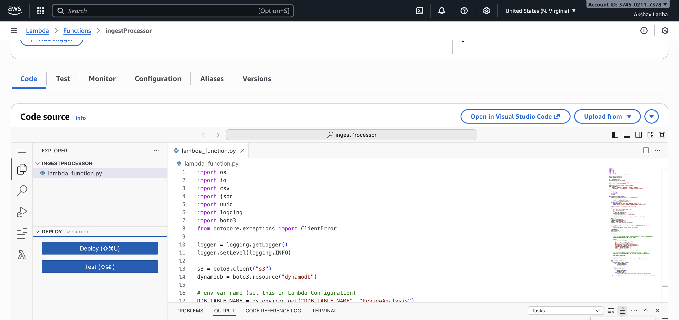
SERVICES USED
AWS Lambda
Two Lambda functions are used:
Ingestion Lambda: Reads CSV from S3, calls Comprehend, stores cleaned data in DynamoDB.

Slide 9
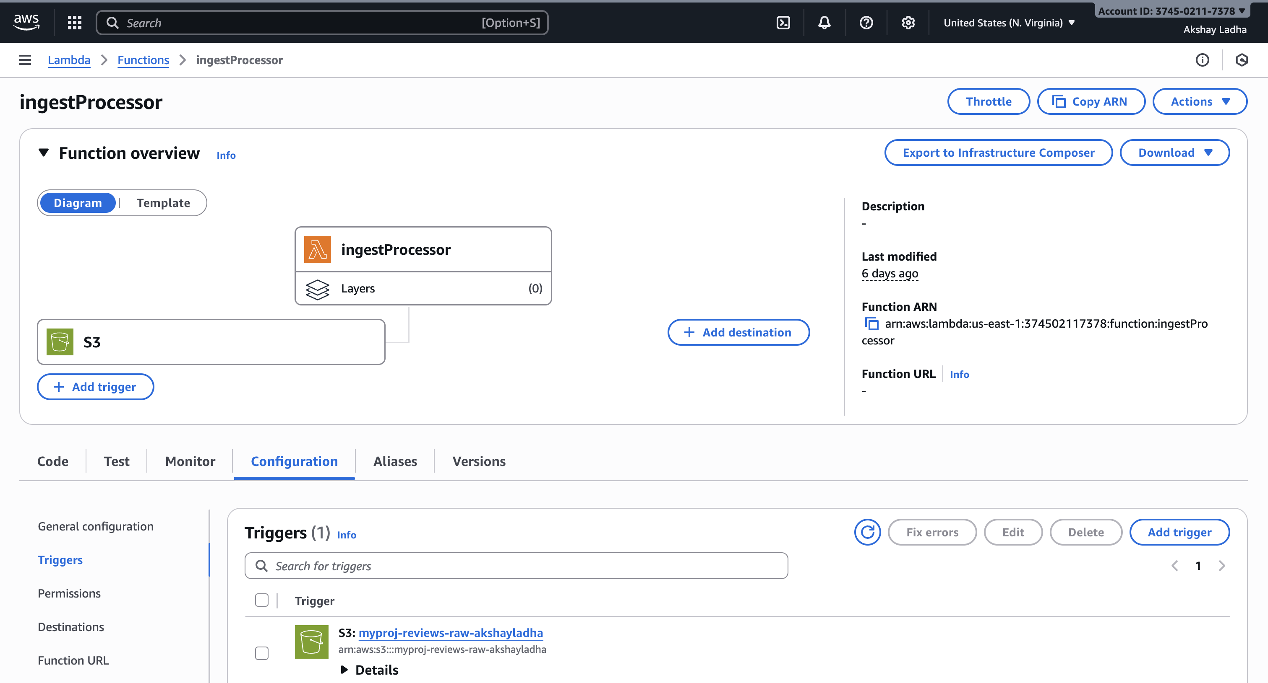
SERVICES USED
Summarization Lambda:
Fetches reviews from DynamoDB, sends them to SageMaker, and stores the summary.
AWS S3 Trigger

Slide 10
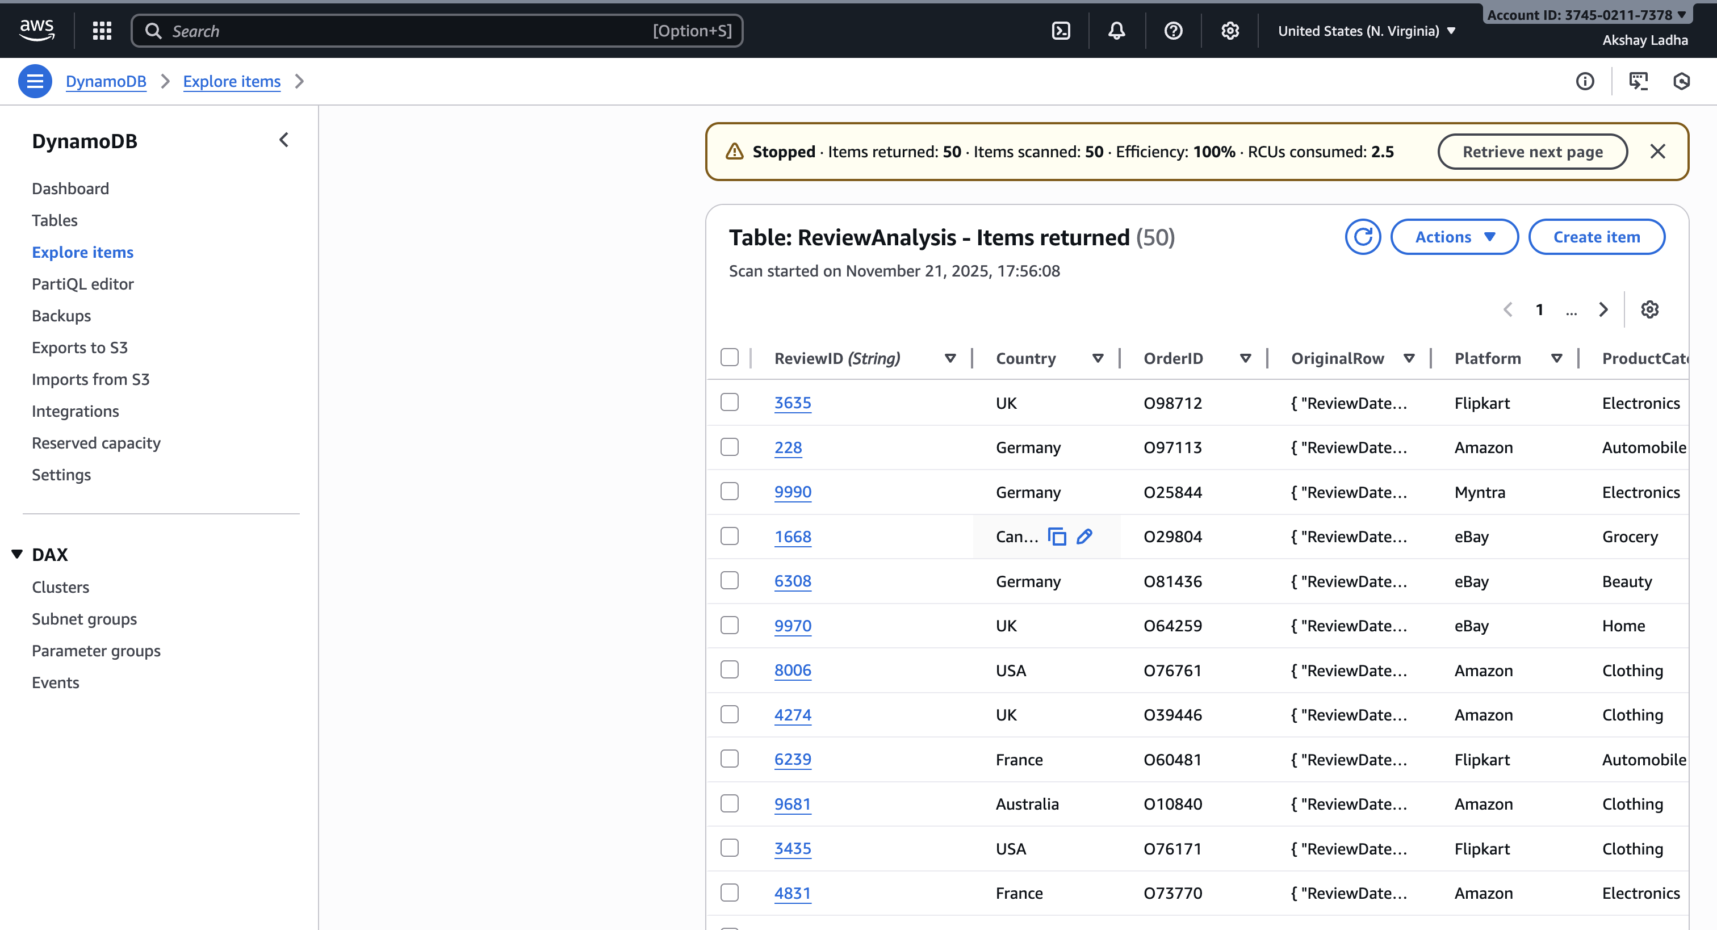
SERVICES USED
Amazon DynamoDB
Serves as the database to store structured review data, including sentiment, rating, key phrases, and generated summaries.

Slide 11
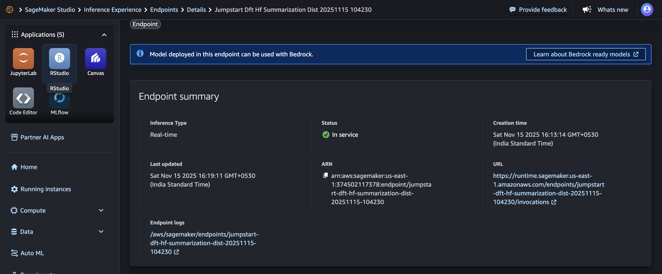
SERVICES USED
Amazon SageMaker (JumpStart Model)
Used to deploy a pre-trained text summarization model, which generates a consolidated summary of all customer reviews.

Slide 12
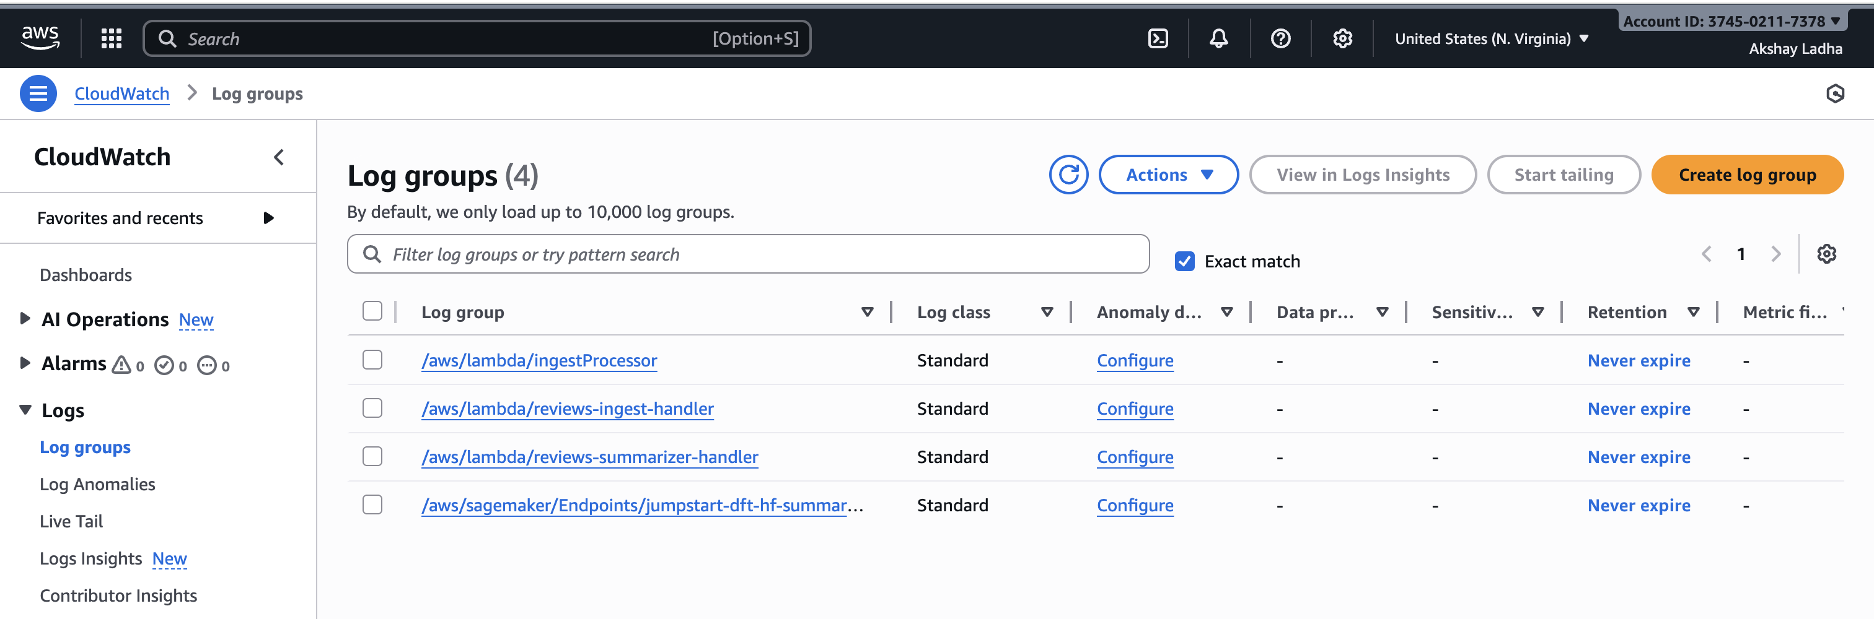
SERVICES USED
Amazon QuickSight and Cloud Watch
Used to create dashboards and visualizations, including KPIs, sentiment distribution, rating analysis, and review tables.
Cloud used for logs monitoring.

Slide 13
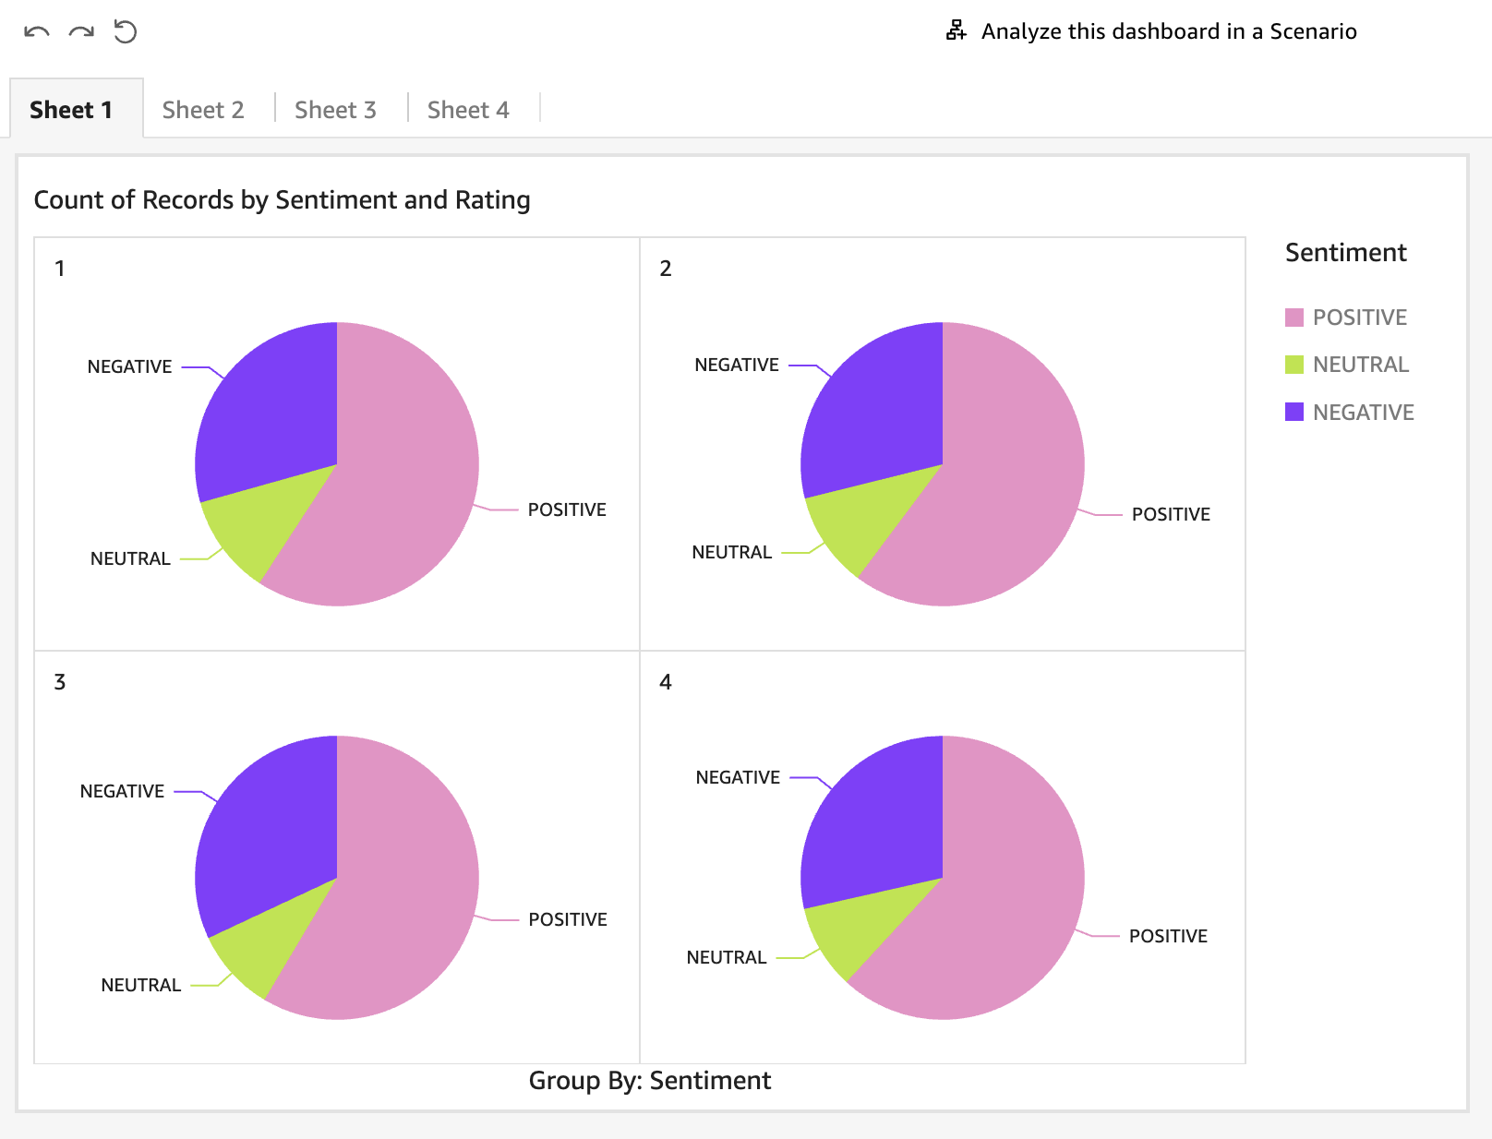
FINAL RESULT
The final QuickSight dashboard provides an interactive, end-to-end visualization of customer reviews, including KPIs, sentiment analysis, keyword insights, and product category trends, enabling clear and actionable business insights.

Slide 14
FUTURE ENAHNCEMENT
Incorporate Amazon Kinesis to handle customer reviews in real time instead of relying on batch uploads, enabling immediate sentiment analysis and live dashboard refreshes.
Add Amazon Translate to automatically convert multilingual reviews into English, making them ready for Comprehend-based analysis.
Leverage Amazon SageMaker to create a recommendation model that suggests products by learning from sentiment trends and key phrases in customer feedback.
Use Amazon SNS to trigger instant notifications when there’s a spike in negative sentiment or when critical keywords like “refund” or “damaged” appear frequently.

Slide 15


